Slide 1
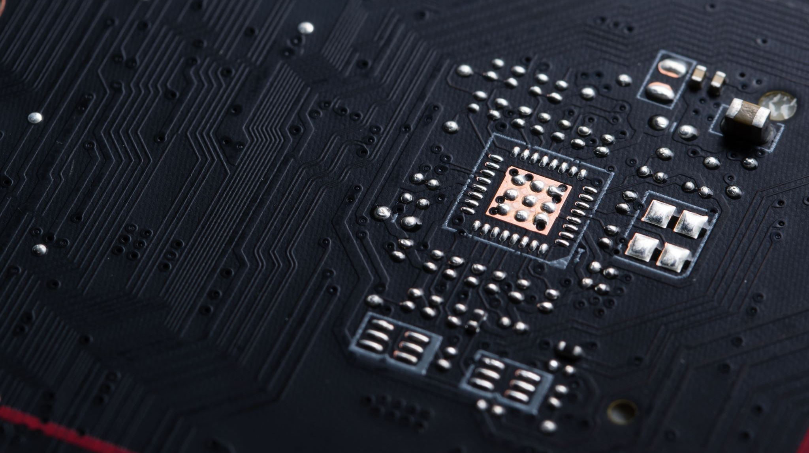
CircuitGuard – PCB Defect Detection and Classification System
M Venkata Satheesh

Slide 2
Problem Statement
Manual PCB inspection is time-consuming and error-prone.
1
Traditional AOI systems produce false positives and require human validation.
2
Complex, miniaturized PCBs demand automated, intelligent inspection.
3
Goal: Develop a deep-learning-based system to accurately detect and classify PCB defects.
4

Slide 3
Project Objectives
Detect and classify PCB defects automatically.
Implement image subtraction and contour-based ROI extraction.
Train an EfficientNet-B4 model for defect classification.
Build a web-based interface for uploading images and viewing results.
Enable export of annotated outputs and prediction logs.

Slide 4

System Modules
Image Preprocessing & Subtraction
Contour Extraction & ROI Segmentation
EfficientNet-B4 Model Training
Frontend (Web UI) Development
Backend Pipeline Integration
Testing, Evaluation & Exporting

Slide 5
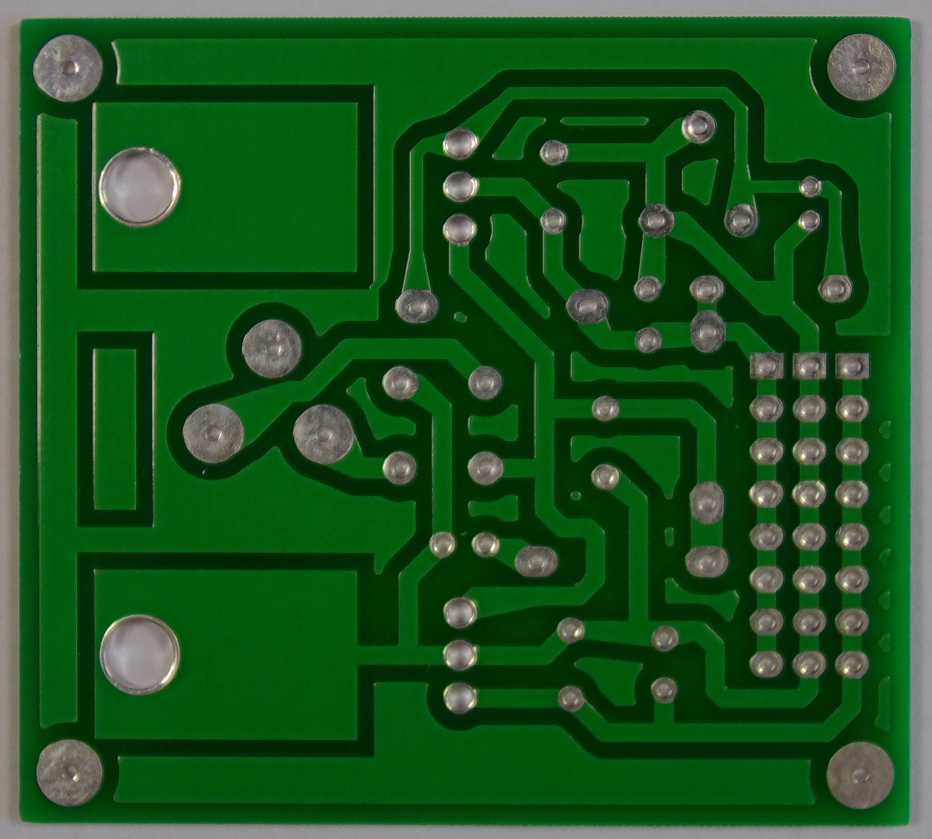
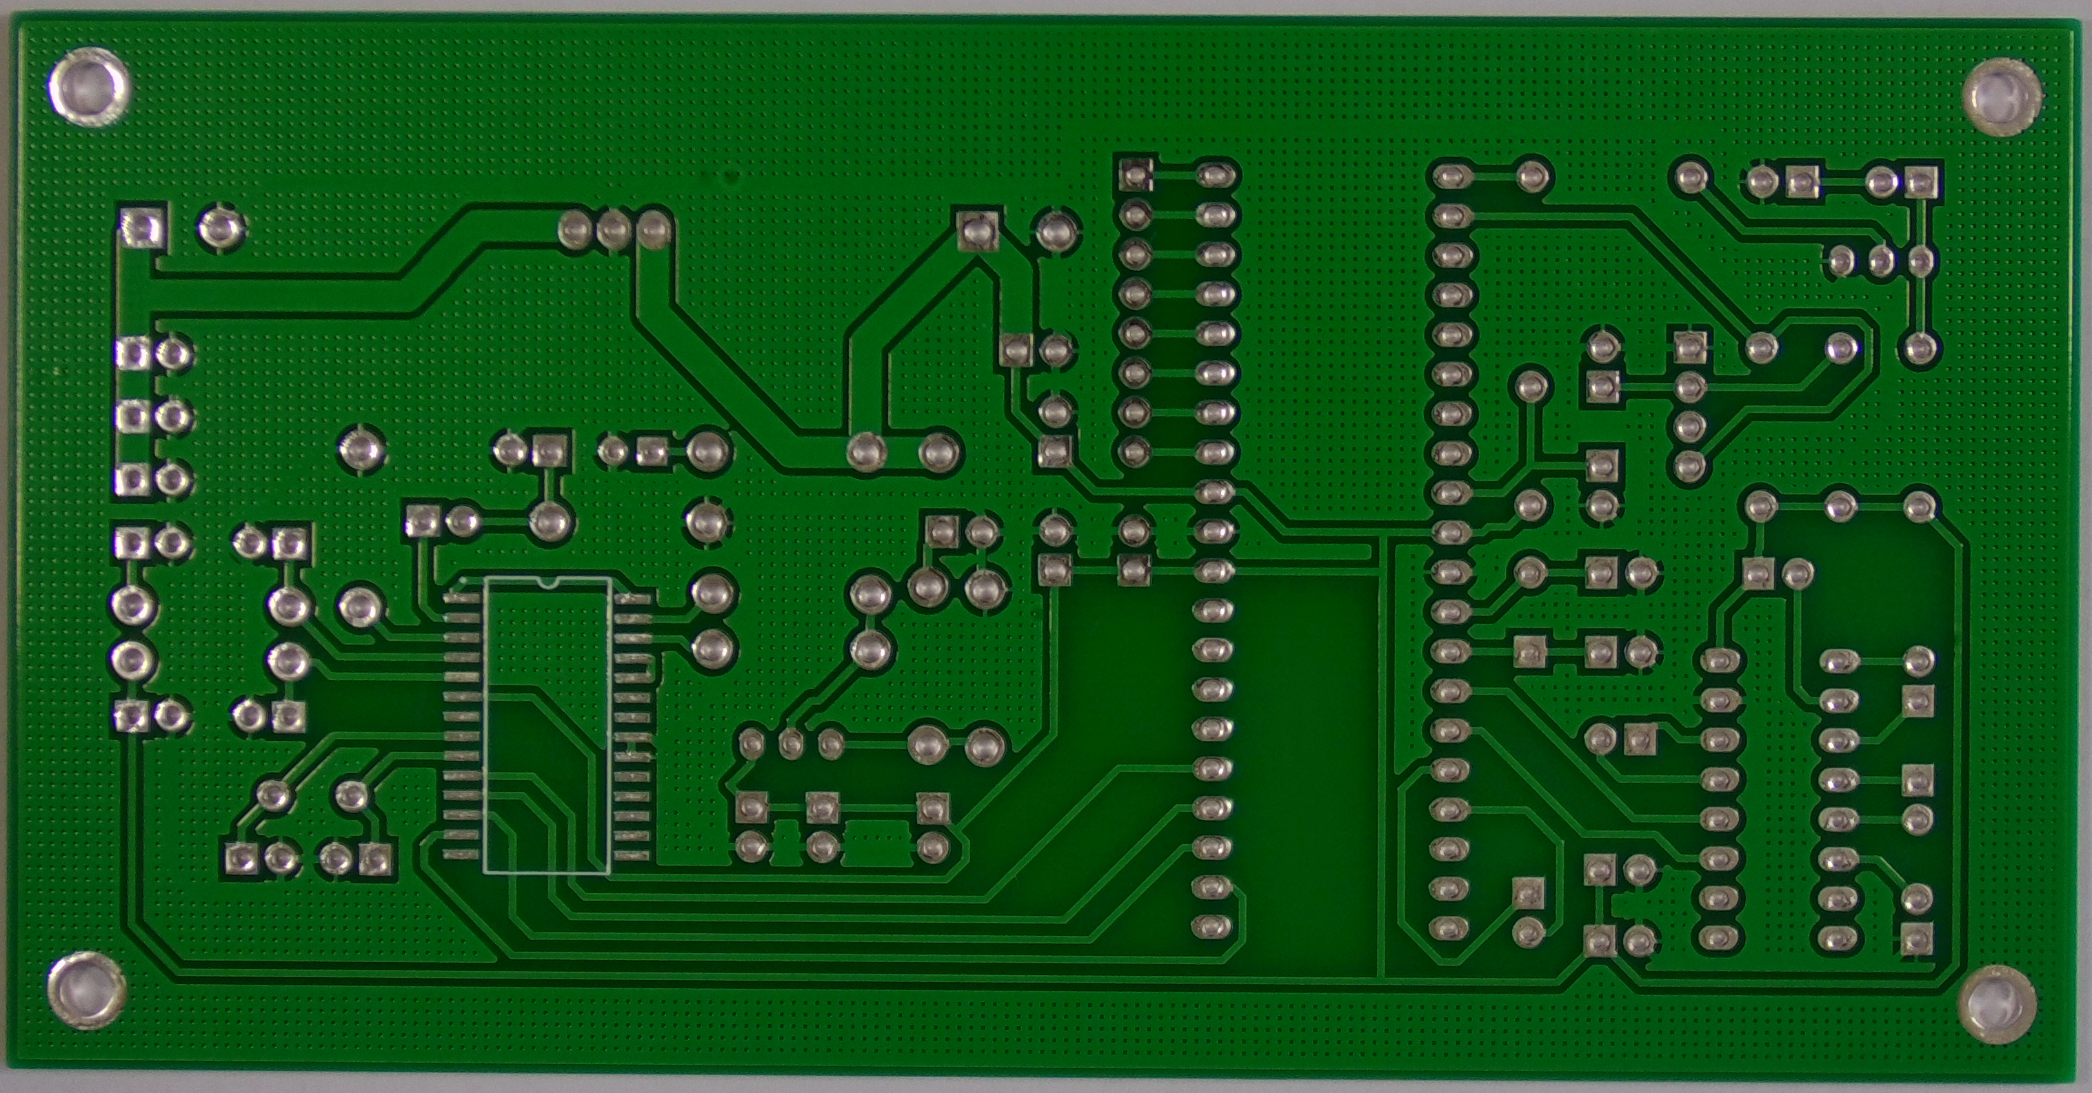
Dataset Overview
Dataset: PCB_circuit
Contains template (defect-free) and test (defective) image pairs.
Defect Types: Missing Hole, Mouse Bite, Open Circuit, Short, Spur, Spurious Copper
Image Resolution: 512 × 512 pixels

Slide 6
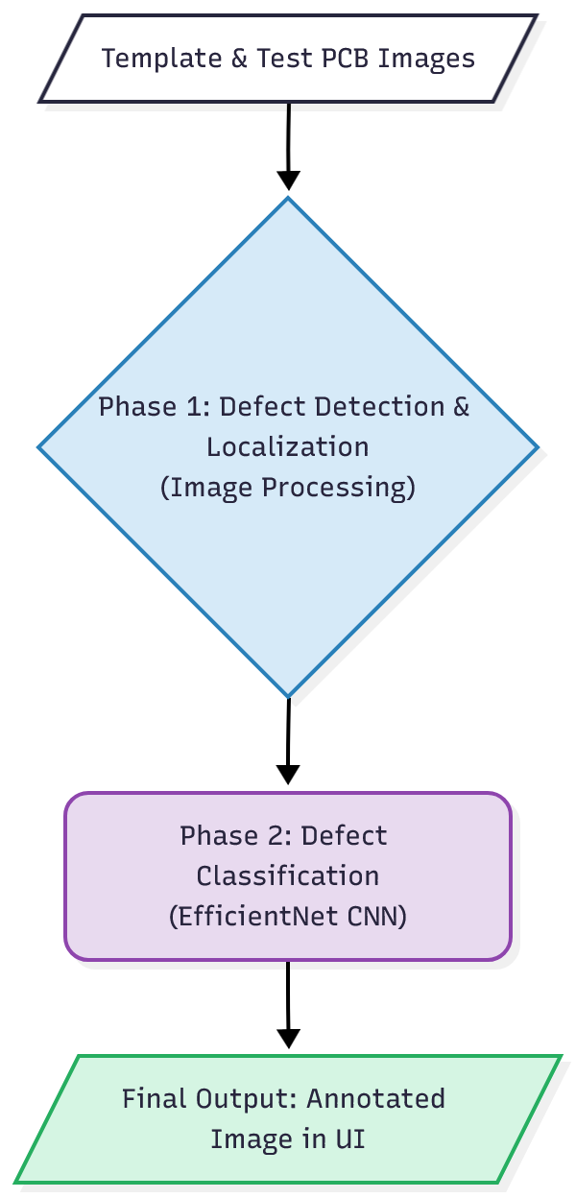
Methodology
Image Subtraction to highlight defect regions.
Otsu’s Thresholding for binary mask generation.
Contour Detection to locate defects.
ROI Cropping for defect samples.
EfficientNet-B4 CNN trained using PyTorch for classification.
Output: Annotated image + Prediction log.

Slide 7
Training Performance
Training Accuracy: 99%
Validation Accuracy: 97%
Model converged smoothly with minimal overfitting.
EfficientNet achieved high generalization on unseen data.
Defect Type | Precision | Recall | F1-Score
Missing Hole | 1.00 | 1.00 | 1.00
Mouse Bite | 0.95 | 0.94 | 0.94
Open Circuit | 0.96 | 0.93 | 0.94
Short | 0.92 | 0.97 | 0.94
Spur | 0.96 | 0.90 | 0.93
Spurious Copper | 0.94 | 0.97 | 0.95

Slide 8
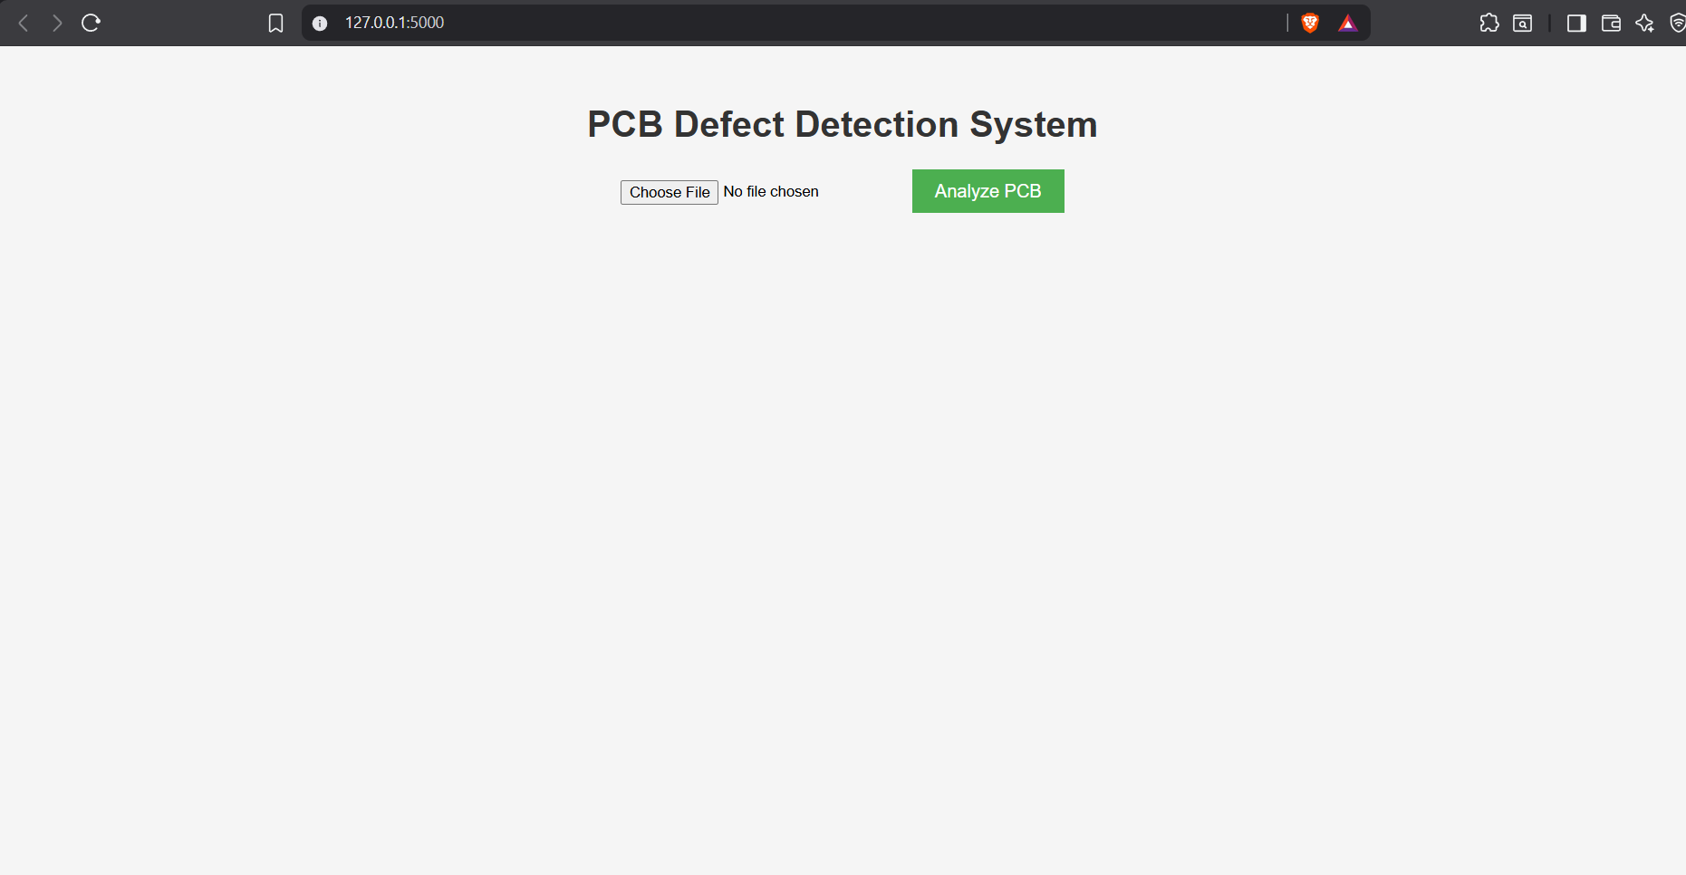
Web Application Interface
Built with HTML/CSS/Flask Upload: Template & Test PCB images.
Backend performs processing and model inference.
Output: Annotated image with defect labels + CSV log.
Response time ≈ 5 seconds per image.

Slide 9
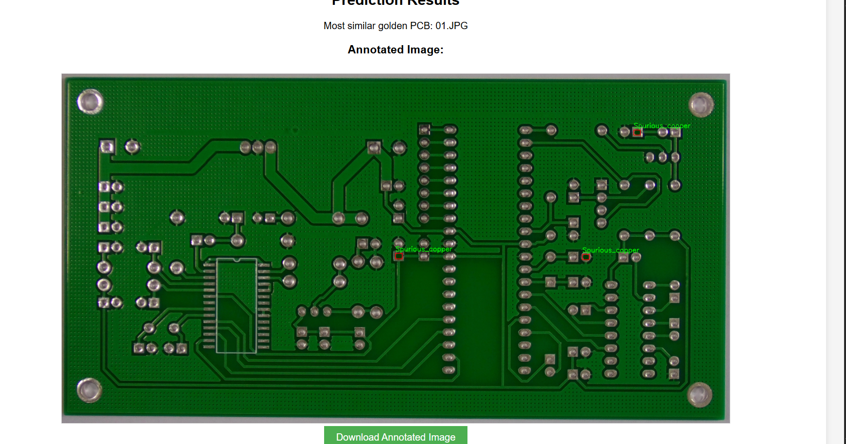
Output Demonstration
System Output Overview:
The application generates annotated PCB images with bounding boxes and defect labels.
A prediction log (CSV file) is automatically created for detailed analysis.
Both outputs can be downloaded directly from the web interface.

Slide 10
Conclusion
Successfully developed an end-to-end automated PCB Defect Detection and Classification System.
Achieved an impressive 97% overall accuracy using the EfficientNet-B4 deep learning model.
Implemented a complete image processing and inference pipeline integrating PyTorch, and a web-based frontend.
The system delivers fast, reliable, and highly accurate defect detection, enabling smarter and more efficient PCB quality inspection.
Represents a scalable, industry-ready solution for modern electronics manufacturing.

